Slide 1
Calorie Counter Survey
W200 Object Oriented Programming Project

Slide 2
Objective
Receive input from the user about various health attributes and their goal.
Provide a recommendation of required Calorific intake to work towards their goal.
Be able to store each survey.
Be able to view an existing survey.
Be able to delete an existing survey.

Slide 3
Object Oriented Structure
User_info
Goal
Customer_Care
User_info
Provide instructions
Receive commands
Store/view/delete surveys
Store user information (age, sex, height, weight)
Calculate required attributes (BMI, BMR)
Store user’s goal
Recommendation
Receive Goal, User_info and Exercise objects as input
Calculate and store recos
Survey
Exercise
Survey object stores user data and recommendation as a dict
Store exercise information (frequency, intensity)
Calculate required attributes (exercise level)
InputError
Customer Error class to handle some input errors differently

Slide 4
Flow
User input
InputError
Customer_Care
User_info
Exercise
__init__
Goal
Recommendation
data
Survey
__init__

Slide 5
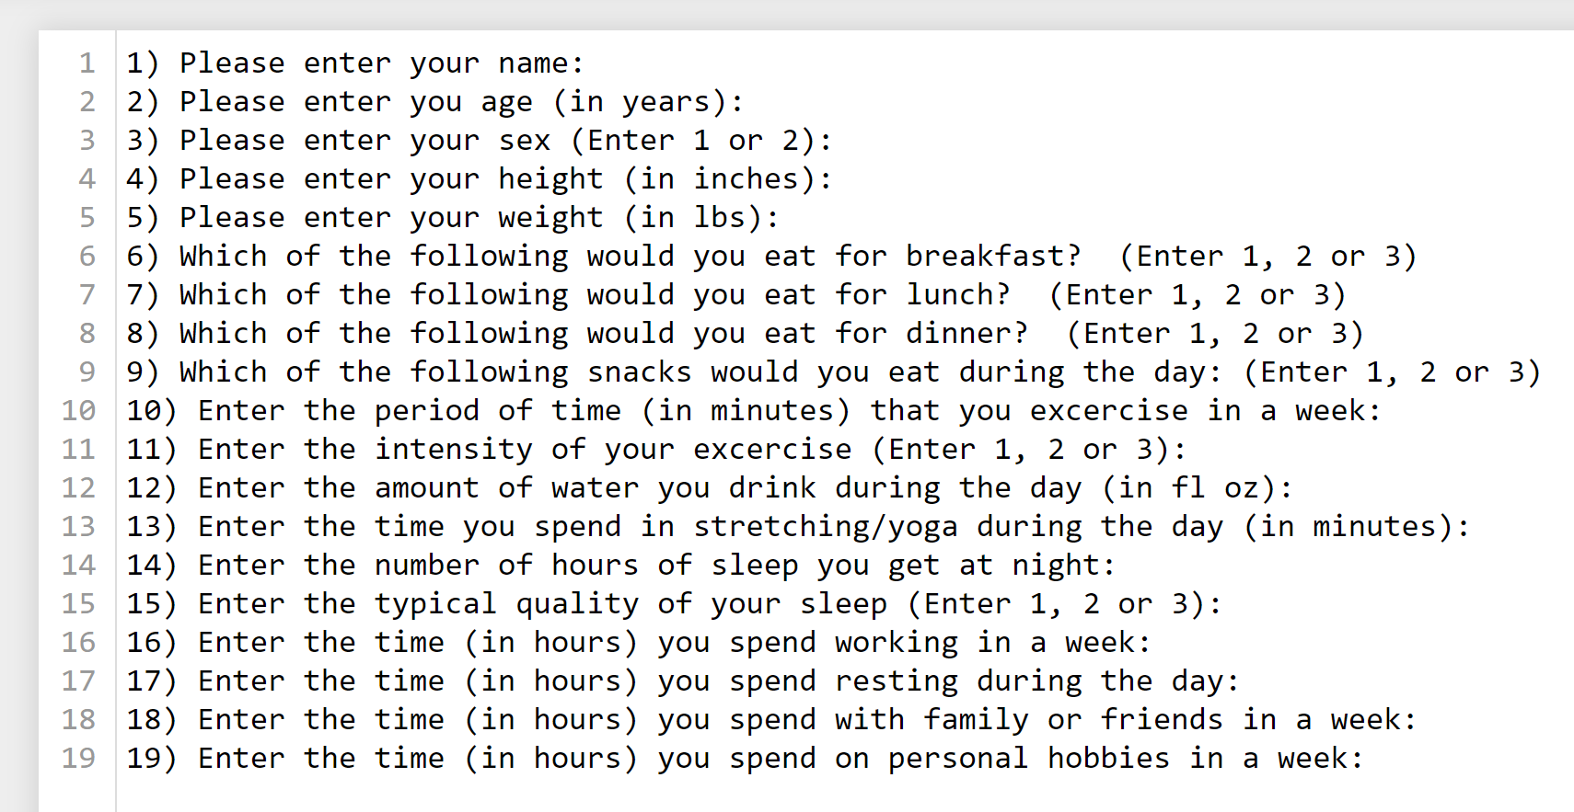
Other thoughts
Proposal scope was very large
Choice for simple and doable
Top-down style worked better
Deciding where user input is received, errors are handled

